Slide 1
Data Driven Approach to a Successful Cloud Migration
{{val:bq--intro.csv[1:2]}}
Analysis for System: {{val:bq--intro.csv[1:1]}}
{{val:bq--intro.csv[1:8]}}, {{val:bq--intro.csv[1:9]}}
{{val:bq--intro.csv[1:7]}}

Slide 2
Agenda
Plan for Ongoing Success in the Cloud
BigQuery Background
Key System Metrics
System Analysis
Data Transfer
Architectural Consideration
System Platform Limitations
Dictionary and Schema Analysis
Summary

Slide 3
Plan for Ongoing Success in the Cloud
Getting a Lay of the Land

Slide 4

Cloud is the Future of Infrastructure But not all Cloud Software is Equal
Understanding the lay of the land helps to avoid problems in advance

Slide 5




Vantage Platform Consumption Analysis
To provide a high–level view of the platform environment
Consumption
Indexes
Columns
Quotas
Dictionary Analysis

Slide 6
BigQuery Background

Slide 7

BigQuery Architecture Promises a LOT
But there are limitations

Slide 8

Structural Overview of BigQuery
BigQuery data storage via Colossus
BigQuery Service
Project X
Project Y
Dataset A
Dataset B
Dataset C
Dataset D
Table 1
Table 1
Table 1
Table 1
Table 2
Table 2
Table 2
Table 2
Notes:
https://cloud.google.com/solutions/bigquery-data-warehouse#datasets
Datasets – BigQuery organizes data tables into units called datasets. These datasets are scoped to your Google Cloud project. When you reference a table from the command line, in SQL queries, or in code, you refer to it by using the following construct:
project.dataset.table

Slide 9
BigQuery Slots Allocation
Processing layer for query execution
1
1
2
2
1
…
…
2
999
1,999
1
…
1,000
2,000
2
…
…
…
1
1
100
9,999
..
10,000
1
50
Notes:
https://cloud.google.com/bigquery/docs/slots
When BigQuery executes a query job, it converts the declarative SQL statement into a graph of execution, broken up into a series of query stages, which themselves are composed of more granular sets of execution steps. BigQuery leverages a heavily distributed parallel architecture to run these queries, and the stages model the units of work that many potential workers may execute in parallel. Stages communicate with one another by using a fast distributed shuffle architecture, which has been discussed in more detail elsewhere.
BigQuery query execution is dynamic, which means that the query plan can be modified while a query is in flight. Stages that are introduced while a query is running are often used to improve data distribution throughout query workers.
BigQuery can run multiple stages concurrently. BigQuery can leverage speculative execution to accelerate a query, and BigQuery can dynamically repartition a stage to achieve optimal parallelization.
BigQuery slots execute individual units of work at each stage of the query. For example, if BigQuery determines that a stage's optimal parallelization factor is 10, it requests 10 slots to process that stage.
Query execution under slot resource economy
If a query requests more slots than currently available, BigQuery queues up individual units of work and waits for slots to become available. As forward progress on query execution is made, and as slots free up, these queued up units of work get dynamically picked up for execution.
BigQuery can request any number of slots for a particular stage of a query. The number of slots requested is not related to the amount of capacity you purchase, but rather an indication of the most optimal parallelization factor chosen by BigQuery for that stage. Units of work queue up and get executed as slots become available.
When query demands exceed slots you committed to, you are not charged for additional slots, and you are not charged for additional on-demand rates. Your individual units of work simply queue up.
For example,
A query stage requests 2,000 slots, but only 1,000 are available.
BigQuery consumes all 1,000 slots and queues up the other 1,000 slots.
Thereafter, if 100 slots finish their work, they dynamically pick up 100 units of work from the 1,000 queued up units of work. 900 units of queued up work will remain.
Thereafter, if 500 slots finish their work, they dynamically pick up 500 units of work from the 900 queued up units of work. 400 units of queued up work will remain.
And so on.

Slide 10
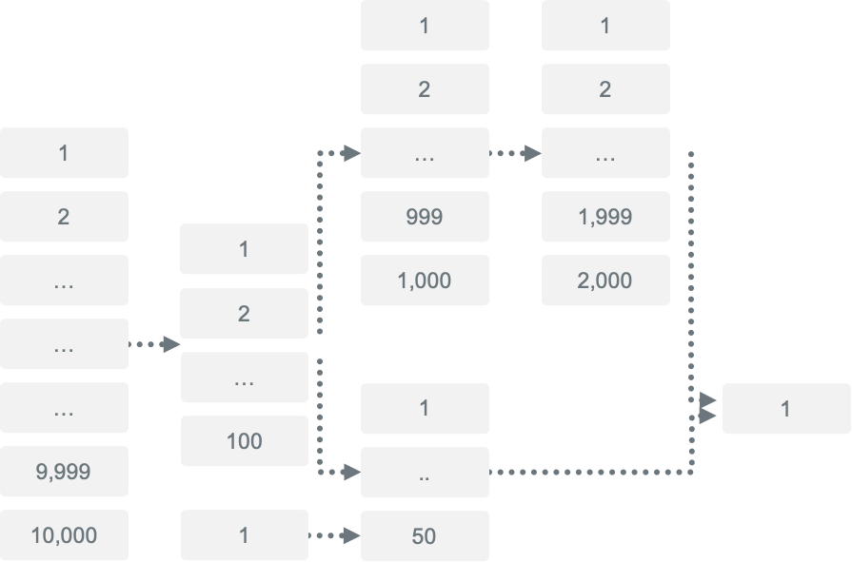
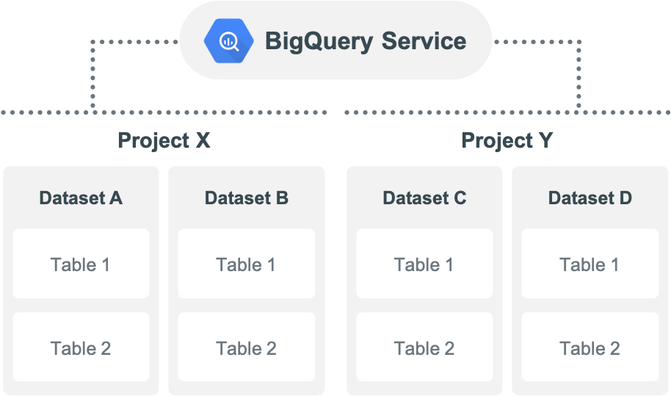
Placing Pressure on BigQuery
Stressing the link between storage and compute…
Storage
Compute
Notes:
https://cloud.google.com/bigquery/docs/slots
When BigQuery executes a query job, it converts the declarative SQL statement into a graph of execution, broken up into a series of query stages, which themselves are composed of more granular sets of execution steps. BigQuery leverages a heavily distributed parallel architecture to run these queries, and the stages model the units of work that many potential workers may execute in parallel. Stages communicate with one another by using a fast distributed shuffle architecture, which has been discussed in more detail elsewhere.
BigQuery query execution is dynamic, which means that the query plan can be modified while a query is in flight. Stages that are introduced while a query is running are often used to improve data distribution throughout query workers.
BigQuery can run multiple stages concurrently. BigQuery can leverage speculative execution to accelerate a query, and BigQuery can dynamically repartition a stage to achieve optimal parallelization.
BigQuery slots execute individual units of work at each stage of the query. For example, if BigQuery determines that a stage's optimal parallelization factor is 10, it requests 10 slots to process that stage.
Query execution under slot resource economy
If a query requests more slots than currently available, BigQuery queues up individual units of work and waits for slots to become available. As forward progress on query execution is made, and as slots free up, these queued up units of work get dynamically picked up for execution.
BigQuery can request any number of slots for a particular stage of a query. The number of slots requested is not related to the amount of capacity you purchase, but rather an indication of the most optimal parallelization factor chosen by BigQuery for that stage. Units of work queue up and get executed as slots become available.
When query demands exceed slots you committed to, you are not charged for additional slots, and you are not charged for additional on-demand rates. Your individual units of work simply queue up.
For example,
A query stage requests 2,000 slots, but only 1,000 are available.
BigQuery consumes all 1,000 slots and queues up the other 1,000 slots.
Thereafter, if 100 slots finish their work, they dynamically pick up 100 units of work from the 1,000 queued up units of work. 900 units of queued up work will remain.
Thereafter, if 500 slots finish their work, they dynamically pick up 500 units of work from the 900 queued up units of work. 400 units of queued up work will remain.
And so on.

Slide 11
Key System Metrics
{{val:bq--intro.csv[1:1]}}

Slide 12
Key System Metrics
Summary
{{val:bq--query_counts.csv[1:11]}}B
Annual queries
{{val:bq--appid_counts.csv[1:3]}}
Applications on same platform
{{val:bq--query_counts.csv[1:8]}}M
Average queries per month
{{val:bq--query_counts.csv[1:6]}}M
Average queries per day
{{val:bq--user_counts.csv[1:3]}}
Active users, business and applications
{{val:bq--query_counts.csv[1:15]}} secs
Average response time
{{val:bq--concurrency.csv[1:5]}}
Concurrent queries (peak)

Slide 13
Key System Metrics
Total Users | {{val:bq--user_counts.csv[1:2]}}
Active Users | {{val:bq--user_counts.csv[1:3]}}
Tables | {{val:bq--object_counts.csv[1:2]}}
Views | {{val:bq--object_counts.csv[1:3]}}
Programs | {{val:bq--object_counts.csv[1:4]}}
Other | {{val:bq--object_counts.csv[1:5]}}
Queries per Second | {{val:bq--query_counts.csv[1:4]}}
Queries per Day | {{val:bq--query_counts.csv[1:5]}}
Queries per Year | {{val:bq--query_counts.csv[1:9]}}
Maximum Space Available (TB) | {{val:bq--diskspace.csv[1:3]}}
Current Space Used (TB) | {{val:bq--diskspace.csv[1:5]}}
Absolute Peak | {{val:bq--concurrency.csv[1:5]}}
95th Percentile | {{val:bq--concurrency.csv[1:4]}}
50th Percentile / Average | {{val:bq--concurrency.csv[1:2]}}
Average Query Runtime, Seconds | {{val:bq--query_counts.csv[1:15]}}
USERS
OBJECTS
QUERY
DISK SPACE
CONCURRENCY
Notes:
REPLACE02

Slide 14
System Analysis
Associated Migration Challenges

Slide 15
Data Transfers

Slide 16


Ingress and Egress Issues
Ingress of Data
Depends greatly on the connectivity between customers and their cloud providers
No cost
Potential data transfer bottleneck
Egress Charges
Cloud Service Providers like to keep data in and not let it out
“Usually cloud providers charge between 5 and 20 cents per GB every time you move your data from their cloud storage…”
Notes:
https://www.hostdime.com/blog/data-egress-fees-cloud/

Slide 17

Daily Data Transfers
customize
placeholder
text
{{pic:bq--data_transfer.png}}
Inbound
In general, inbound data traffic is significantly lower than outbound traffic for customers, as Vantage excels at large scale analytics in a read-once, use-many architecture.
Outbound
The outbound traffic is helpful in calculating data egress cost after moving to the cloud. Also helps customers to understand where the data gravity lies in the Ecosystem.

Slide 18
Architectural Considerations

Slide 19
Architectural Limitations for BigQuery
Based on internal and 3rd party benchmark experience
Complex Mixed Workloads
Large number of “operational queries”
NOT Ideal for BigQuery
Complicated Join Limitations
Large Table Limitations

Slide 20
Daily Queries Throughput
Headline placeholder
Sed elementum turpis orci, non mattis mauris viverra quis. Cras condimentum augue Bibendum.
customize
placeholder
text
Average {{val:bq--query_counts.csv[1:6]}}M per day. {{val:bq--query_counts.csv[1:14]}} % of the queries are sub-second
Headline placeholder
Sed elementum turpis orci, non mattis mauris viverra quis. Cras condimentum augue Bibendum.
XXXX
{{pic:bq--daily_query_throughput.png}}
XXXX

Slide 21
JOIN Frequency
Frequent Multi-Table JOINs
{{pic:bq--join_frequency.png}}
Achieving Strategic Goals via Tactical Queries
Tactical queries cost very little in Vantage.
Single Table queries account for {{val:bq--join_frequency_horz.csv[1:8]}} of the total workload but only consume {{val:bq--join_frequency_horz.csv[1:21]}} of the total CPU. This efficiency enables millions of operational queries to be executed without impacting more complex strategic queries. The SLAs of all the workloads can be guaranteed through Teradata’s Advanced Workload Management capabilities.
Whilst the number of queries involving 6 or more tables represent only {{val:bq--join_frequency_horz.csv[1:13]}} of the total volume, in absolute numbers this still equates to more than {{val:bq--join_frequency_horz.csv[1:6]}} queries over {{val:bq--join_frequency_horz.csv[1:27]}} days. These complex strategic queries deliver the analytic value for the Enterprise.
It can be challenging to run these scenarios in BigQuery:
Millions of tactical queries
Complex multi-way JOINs at scale

Slide 22
Table Size > 10GB
customize
placeholder
text
{{val:bq--10GB_table_count.csv[1:2]}} Tables Exceed 10GB
DataBaseName | TableName | CurrentPerm GB
{{col:bq--10GB_tables.csv[2]}} | {{col:bq--10GB_tables.csv[3]}} | {{col:bq--10GB_tables.csv[4]}}
Forced Denormalization
BigQuery architecture forces the customers to denormalize. This means creating one pipeline per use which results in the scenario called “Pipeline Jungles.”
As per BigQuery technical documentation you should denormalize a dimension table greater than 10GB.
Notes:
REPLACE07

Slide 23

Applications and Data Extracts
customize
placeholder
text
Average Rows Returned
AppID | Total Queries | Total Fetched Rows | Avg Rows Per Query
{{col:bq--appid_detail.csv[1]}} | {{col:bq--appid_detail.csv[3]}} | {{col:bq--appid_detail.csv[4]}} | {{col:bq--appid_detail.csv[5]}}
Limits on Data Export
BigQuery applies a 10GB limit on data export. If an application is exporting 100GB data to another system, then you would have to manually breakdown the query into 10 queries after migration to BigQuery.
Notes:
REPLACE08 -- bq--appid_detail.csv

Slide 24
System Platform Limitations

Slide 25
Understanding Platform Limitations
BigQuery quotas and limits
Description | Limit
Concurrency | 100 queries
Concurrency for external sources | 4 queries
Queries with UDF | 6 queries
Inserts per table | 1500/day/table
Query execution time limit | 6 hours
Load jobs per table per day | 1500
Load jobs per project per day | 100,000
Max # of partitions per table | 4000
Max query response size | 10GB
Notes:
https://cloud.google.com/bigquery/quotas
Customers can request to get some of the limits changed but they will always be finite.
Change to the limits results in extra cost which is not advertised publicly.
Google may increase the daily limits but they will never be eliminated because of the Serverless design

Slide 26
Number of Tables Having > 1500 Insert/Update/Delete
customize
placeholder
text
On average, {{val:bq--tablecount_over_1500_dml_average.csv[1:2]}} tables break the BigQuery limits on a daily basis
{{pic:bq--tablecount_over_1500_dml.png}}
Architectural Limitations
BigQuery limits what customers can do with their data. Users can only run 1500 INSERTS / UPDATES / DELETES per table per day. Attempting to run query 1501 will result in an error message.
Google will argue that 1500 queries is soft limit, which they can remove—and might do so for large customers. However, the fact that the limit exists suggests that there are underlying limitations which force Google to restrict users from doing their work.

Slide 27
Databases with Most Frequent INSERTS/UPDATES/DELETES
customize
placeholder
text
On average, {{val:bq--tablecount_over_1500_dml_average.csv[1:2]}} tables break the BigQuery limits on a daily basis
ObjectDatabaseName | Avg Statement Count Per Table
{{col:bq--databases_most_dml_tables.csv[1]}} | {{col:bq--databases_most_dml_tables.csv[2]}}
Architectural Limitations
BigQuery limits what customers can do with their data. Users can only run 1500 INSERTS / UPDATES / DELETES per table per day. Attempting to run query 1501 will result in an error message that says, “Query failed today, try again tomorrow”.
Google will argue that 1500 queries is soft limit, which they can remove—and might do so for large customers. However, the fact that the limit exists suggests that there are underlying limitations which force Google to restrict users from doing their work.
Notes:
REPLACE10

Slide 28
Dictionary and Schema Analysis

Slide 29

GAPS IN BIGQUERY
Blockers to Successful Migration
Primary Indexes
Not having PI will require complete remodeling and will dramatically reduce performance, especially for tactical queries.
{{val:bq--constraints.csv[1:2]}} UPI Defined
Table Structures
SET tables enforce uniqueness automatically; absence of this capability will require moving this complex logic to ETL.
Global Temporary tables will need to be handled in the ETL, as well.
{{val:bq--tablekind_by_database.csv[1:5]}} SET tables out of {{val:bq--tablekind_by_database.csv[1:2]}} ({{val:bq--tablekind_by_database.csv[1:6]}})
{{val:bq--tablekind_by_database.csv[1:7]}} Global Temporary Tables
{{val:bq--tablekind_by_database.csv[1:4]}} Queue Tables
{{val:bq--tablekind_by_database.csv[1:3]}} Join Indexes
Constraints
All the constraints handled by the database would need to be handled by ETL, which will significantly increase ETL effort and can cause reconciliation issues.
{{val:bq--constraints.csv[1:6]}} Check Column Constraints
{{val:bq--constraints.csv[1:3]}} Primary Key Constraints
{{val:bq--constraints.csv[1:5]}} Foreign Key Constraints
Notes:
System database excluded:
DatabaseName NOT IN ('All', 'Crashdumps', 'DBC', 'dbcmngr’, 'Default', 'External_AP', 'EXTUSER', 'LockLogShredder', 'PUBLIC','Sys_Calendar', 'SysAdmin', 'SYSBAR', 'SYSJDBC', 'SYSLIB','SystemFe', 'SYSUDTLIB', 'SYSUIF', 'TD_SERVER_DB', 'TDStats','TD_SYSGPL', 'TD_SYSXML', 'TDMaps', 'TDPUSER', 'TDQCD','tdwm', 'SQLJ', 'TD_SYSFNLIB', 'SYSSPATIAL')

Slide 30
GAPS IN BIGQUERY
Blockers to Successful Migration
Column Formatting
Column Formatting allows users to control data type precision. If not handled properly in the ETL logic, it can cause reconciliation issues.
{{val:bq--column_format_state.csv[1:2]}} Column Formats
Partitioning
Teradata offers multi-level partitioning that is not found in other databases. Lack of this feature will result in significantly worse performance for partitioned queries.
{{val:bq--Index_summary.csv[1:3]}} PPI Defined
Special Data Types
These data types provide specialized business capabilities such as Time Series, Geospatial, Temporal, and Unstructured Data processing. Absence of the data types will make it difficult to provide high-level business capabilities.
{{val:bq--column_formats.csv[1:3]}} INTERVAL
{{val:bq--column_formats.csv[1:4]}} PERIOD
{{val:bq--column_formats.csv[1:5]}} NUMBER
{{val:bq--column_formats.csv[1:6]}} BLOB > 8MB
{{val:bq--column_formats.csv[1:7]}} CLOB > 16MB
{{val:bq--column_formats.csv[1:8]}} XML/JSON
{{val:bq--column_formats.csv[1:9]}} Geospatial
Notes:
System database excluded:
DatabaseName NOT IN ('All', 'Crashdumps', 'DBC', 'dbcmngr’, 'Default', 'External_AP', 'EXTUSER', 'LockLogShredder', 'PUBLIC','Sys_Calendar', 'SysAdmin', 'SYSBAR', 'SYSJDBC', 'SYSLIB','SystemFe', 'SYSUDTLIB', 'SYSUIF', 'TD_SERVER_DB', 'TDStats','TD_SYSGPL', 'TD_SYSXML', 'TDMaps', 'TDPUSER', 'TDQCD','tdwm', 'SQLJ', 'TD_SYSFNLIB', 'SYSSPATIAL')

Slide 31
Summary

Slide 32

Vantage Success Through Value Delivery
Understanding platform characteristics
Performance
Quotas and Limits
Schema
Leads to successful migration decisions

Slide 33
Teradata + Public Cloud = Lowest Risk, Fastest Time to Value
Migrating to the same data model and Vantage software accelerates the journey to the cloud,
enables progress in advanced analytics and drives new value
Timeline for Teradata in Public Cloud
Premigration testing
Post migration tuning
ADVANCED AND NEAR-REAL TIME ANALYTICS POWERED BY VANTAGE
Bank of the Future
Cost Efficiency;
CX improvement;
Marketing, Sales & Care services digitization.
Migration delivered
Analytical value being delivered
Migration
Open data platform for business and digital partners
Discovery and analysis
Multi-channel, hyper-personalization of the Customer Journey
2021
2022
2023
2024
Timeline for other Cloud native database offerings
Parallel running to enable business continuity
Extensive re-engineering and parallel running drives high-cost;
Resources and management time diverted merely to re-implement existing functionality.
Data Structure Design
Migration and testing of 30+ high priority applications and associated ETL processes
Migration delivered
Ecosystem analysis
Develop and test new data structure
Rearchitect and develop downstream systems
Subject matter experts and data scientists tied up supporting migration

Slide 34

Questions and Answers

